Slide 1
Using Data Mining to Generate Highly Predictive Aging Clocks
– by Soumyendra Shrivastava
016670121

Slide 2
Introduction →
This article is based on the discoveries showcased in Data mining of human plasma proteins generates a multitude of highly predictive aging clocks that reflect different aspects of aging
Discovery of an ultra-predictive aging clock composed of 491 protein inputs.
Important discovery to predicting and delaying human aging.

Slide 3
Aging Clock →
Used to estimate a person’s age based on physical appearance, health status, cognitive abilities, and emotional well-being.
Used to reflect different aspects of aging, such as physical, mental, and emotional changes.
Used in fields such as medicine, psychology, and law enforcement

Slide 4
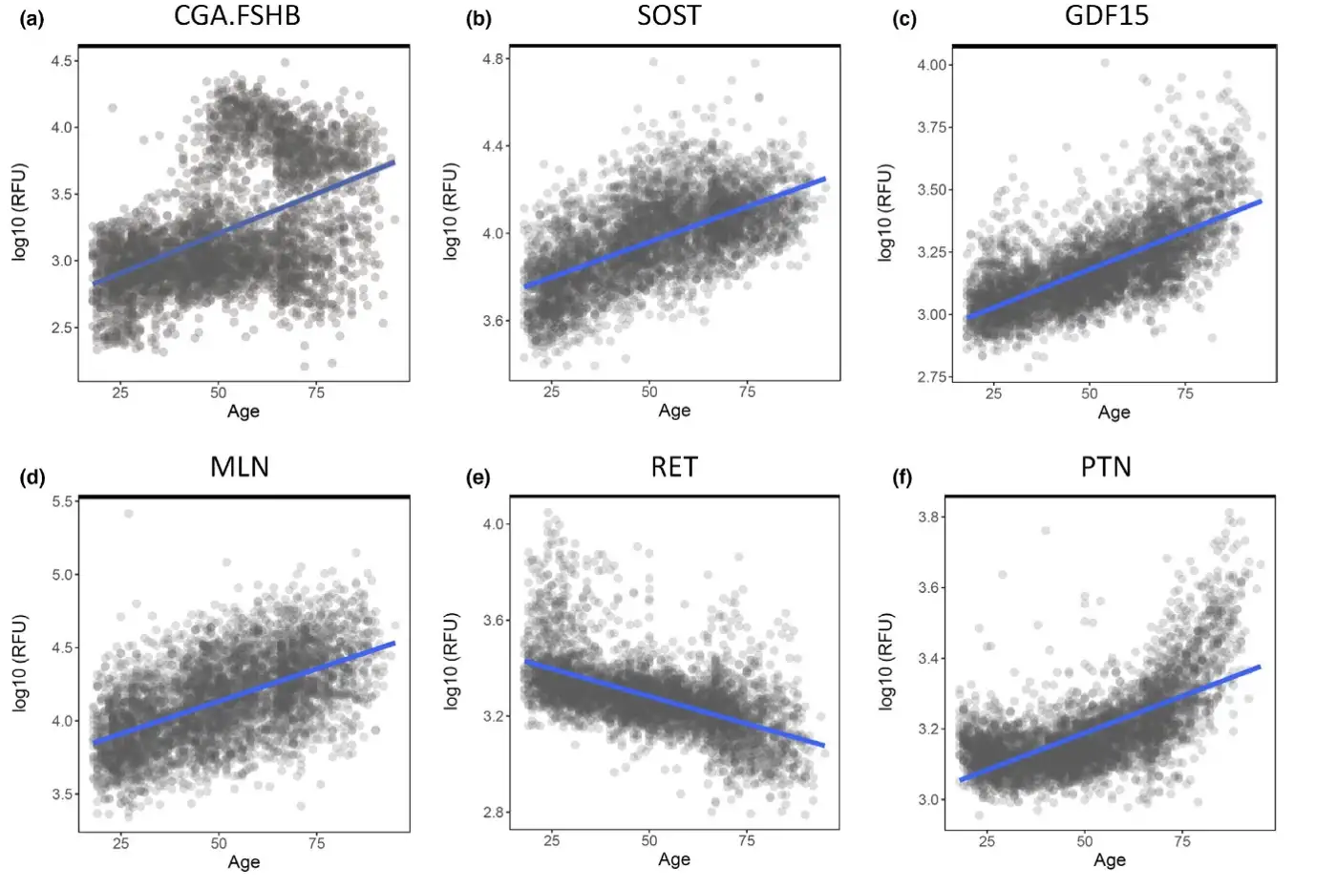
Analysing aging proteins in a Large Proteomics dataset →
Figure:
The six proteins that exhibited the most significant change in plasma expression level with age were CGA.
FSHB (a), SOST (b), GDF15 ©, MLN (d), RET (e), and PTN (f)

Slide 5
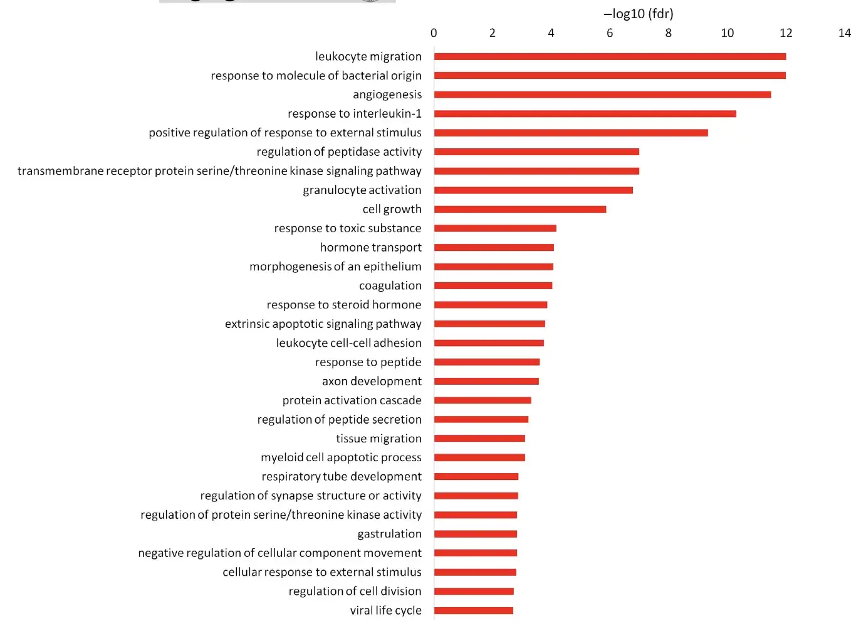
Using Machine Learning for analysis of different Clocks →
Figure:
The top 30 enrichment results as -log10 values (fdr)

Slide 6
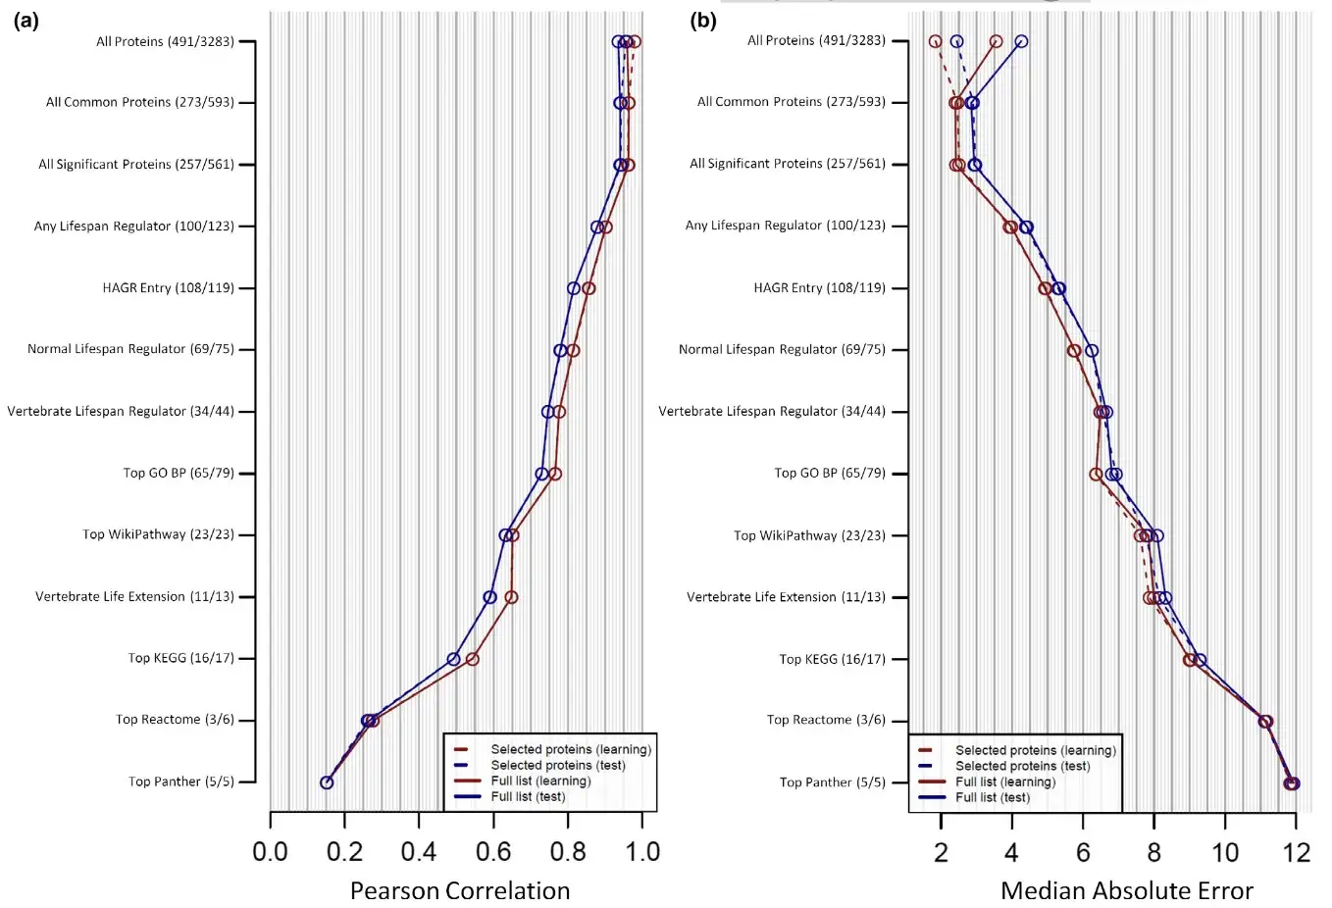
Using Machine Learning for analysis of different Clocks →
Figure:
Pearson correlation and Median absolute error →
Before finalizing Training Model →

Slide 7
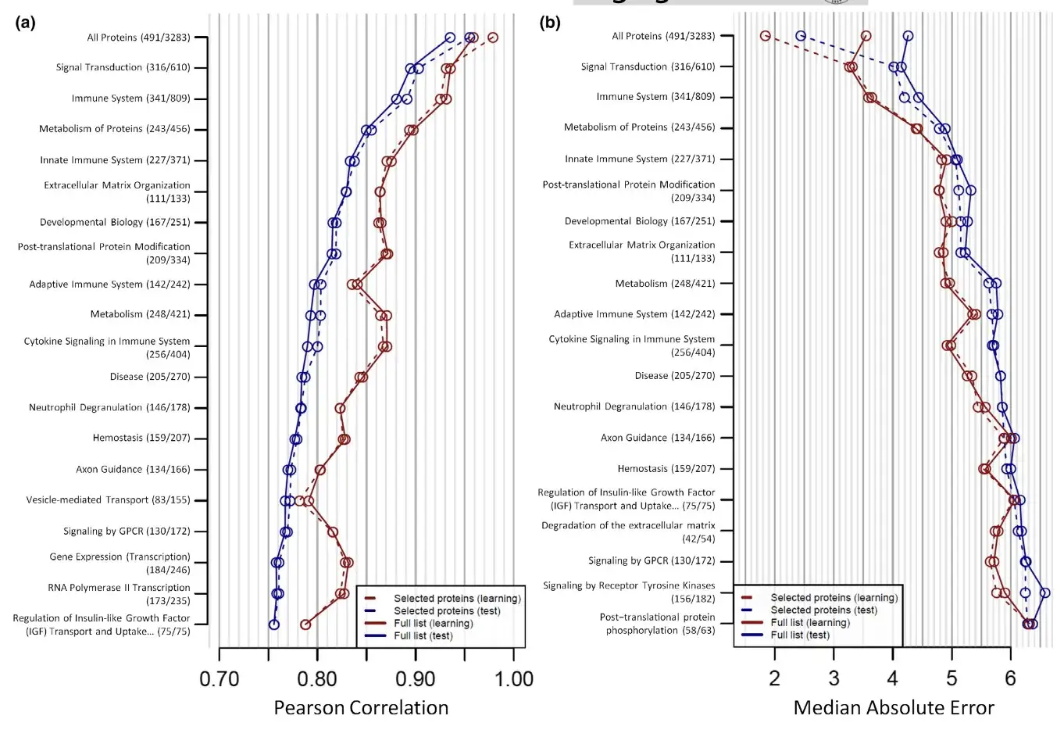
Using Machine Learning for analysis of different Clocks →
After finalizing Training Model →
Figure:
Pearson correlation and Median absolute error →

Slide 8
Experimental Procedures followed →
Statistical measurements
Database and literature search
Overrepresentation analysis
Proteomic aging clock generation
Validation of the ultra-sensitive proteomic clock

Slide 9
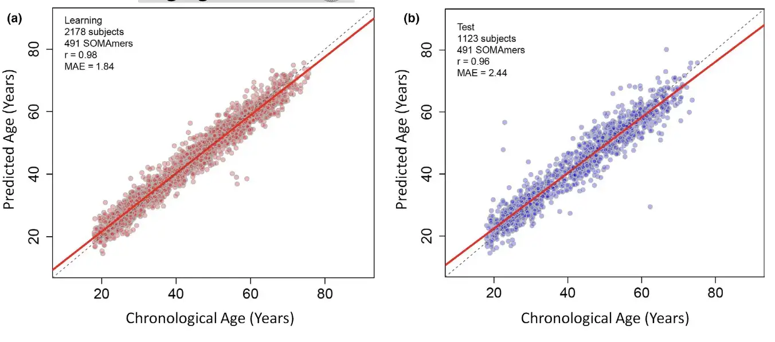
Conclusion →
Figure:
Plots of predicted age vs. chronological age for the most predictive aging clock identified.

Slide 10
References →
[1] Lehallier, B., Shokhirev, M.N., Wyss-Coray, T. and Johnson, A.A. (2020), Data mining of human plasma proteins generates a multitude of highly predictive aging clocks that reflect different aspects of aging. Aging Cell, 19: e13256. https://doi.org/10.1111/acel.13256
[2] Acosta-Herrera, M., Kerick, M., Gonzalez-Serna, D., Myositis Genetics, C., Scleroderma Genetics, C., Wijmenga, C., & Martin, J. (2019). Genome-wide meta-analysis reveals shared new loci in systemic seropositiverheumatic diseases. Annals of the Rheumatic Diseases, 78(3), 311–319.https://doi.org/10.1136/annrh eumdi s-2018–214127
[3] Alliance of Genome Resources, C., Agapite, J., Albou, L.-P., Aleksander, S., Argasinska, J., Arnaboldi, V., Attrill, H., Bello, S. M., Blake, J. A., Blodgett, O., Bradford, Y. M., Bult, C. J., Cain, S., Calvi, B. R., Carbon, S., Chan, J., Chen, W. J., Cherry, J. M., Cho, J., … Yook, K. (2020). Alliance of Genome Resources Portal: Unified model organ -ism research platform. Nucleic Acids Research, 48(D1), D650-D658.https://doi.org/10.1093/nar/gkz813
[4] Bae, J. H., Hong, M., Jeong, H. J., Kim, H., Lee, S. J., Ryu, D., & Kang, J. S. (2020). Satellite cell-specific ablation of Cdon impairs integrin acti -vation, FGF signalling, and muscle regeneration. Journal of Cachexia, Sarcopenia and Muscle, 11(4), 1089–1103. https://doi.org/10.1002/jcsm.12563

